Slide 1
Leverage an LLM to dynamically generate API calls based on freeform text
Tural Mehtiyev

Slide 2
Presentation Outline
Brief information about Large Language Models (LLMs);
What is Function Calling and Why it is useful?
Brief project Overview and use case for Function Calling
Experiment Design
Implementation overview and results

Slide 3
The rapid evolution of Large Language Models (LLM)
… | 2017 | 2018 | 2019 | 2020 | 2021 | 2022 | 2023
Attention Transformer |  | BERT 340M | GPT2 1.5B | GPT3 175B | LaMDA (Bard) 173B | ChatGPT | GPT-4 (1.8T?) MiniGPT-4
MT-NLG | PaLM 540B | LLaMA 1 7-65B LLaMA 2 7-70B
(Megatron- | BLOOM 175B | PaLM (up to 340B)
Turing) 530B | Flan 20B
 | YaLM 100B
GPT1 117M

Slide 4
Encoder-Decoder Architecture
Decoder
Encoder
Feed forward
Feed forward
Encoder-Decoder Attention
Self-Attention
Self-Attention

Slide 5
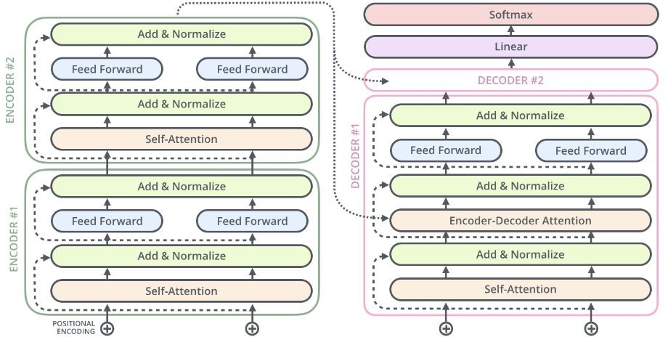
Transformer Architecture (encoder-decoder)

Slide 6
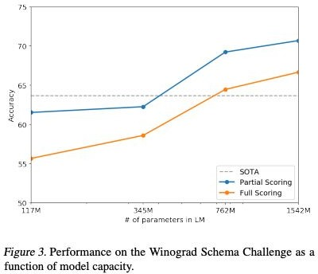
GPT-2
Winograd Example
The city councilmen refused the demonstrators a permit because they [feared/advocated] violence.
If the word is ``feared'', then ``they'' presumably refers to the city council; if it is ``advocated'' then ``they'' presumably refers to the demonstrators.
Incremental advancement to GPT
Introduced WebText dataset - filtered webscape 8M documents and 40GB text
GPT Decoder Transformer
Layer Norm Input to each Transformer Block
Additional Layer Norm to the output of the final Self-Attention Block
Larger vocabulary: 50k
Input context from 512 to 1,024
With 48 Transformer Layers, model size is 1.5B params
Zero-shot SOTA on several language tasks
Radford, A., et al., (2019) Language Models are Unsupervised Multitask Learners

Slide 7
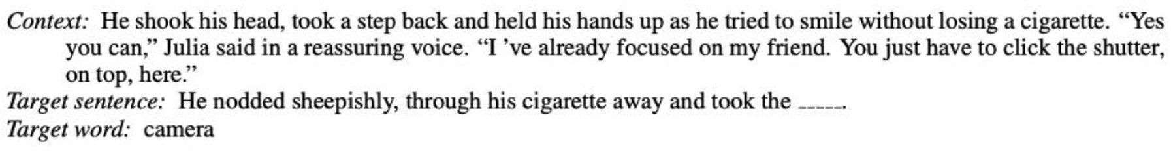
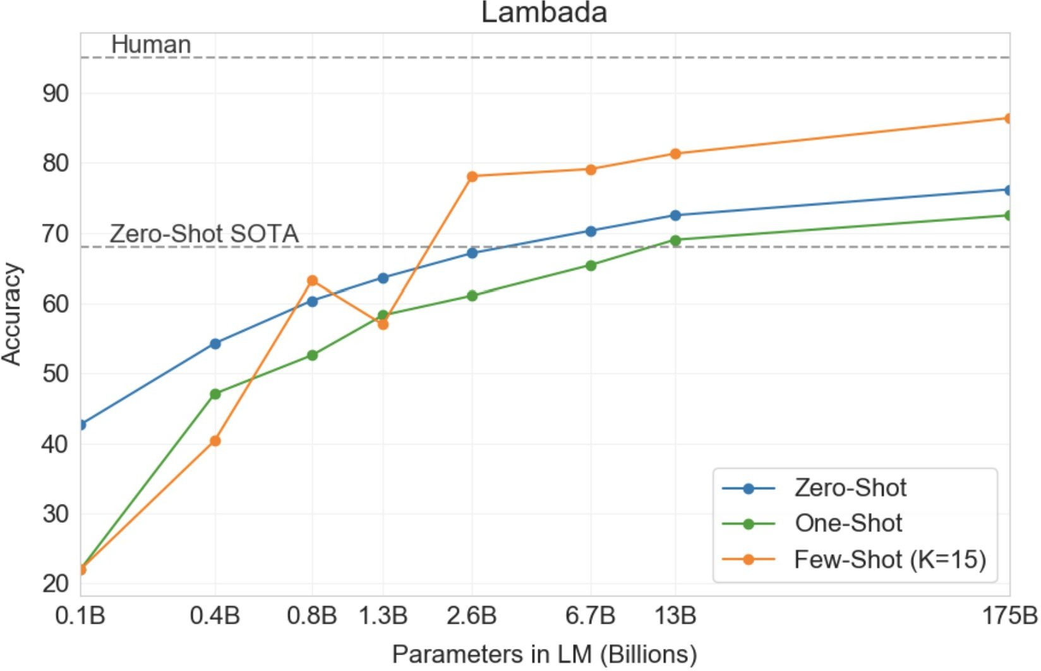
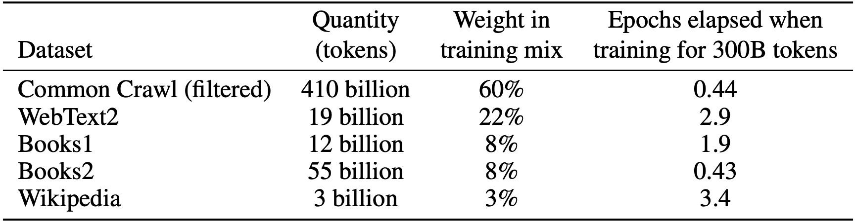
GPT-3
Demonstrated SOTA performance in few-shot, one-shot, and zero-shot learning
Architecture same as GPT-2, except GPT-3 transformer use alternating dense and locally banded sparse attention patterns
8 Models trained ranging from 125M - 125B params, and a context length of 2,048
Significantly larger training corpus
Considers effects of misinformation; evaluates bias in race, gender and religion and broader societal impacts
Brown. T., et al., (2020) Language Models are Few-Shot Learners

Slide 8

GPT-4 (Unofficial Info)
Model architecture is not officially published
GPT-4 has ~1.8 trillion parameters across 120 layers
10 times larger than GPT-3
Ensemble of experts
Fine-tuned using RLHF (official)
Dataset
~13T tokens, including both text-based and code-based data, with some fine-tuning data from ScaleAI and internally.
Included CommonCrawl & RefinedWeb, totaling 13T tokens. Speculation suggests additional sources like Twitter, Reddit, YouTube, and a large collection of textbooks.
The Decoder: GPT-4 architecture, datasets, costs and more leaked https://the-decoder.com/gpt-4-architecture-datasets-costs-and-more-leaked/

Slide 9
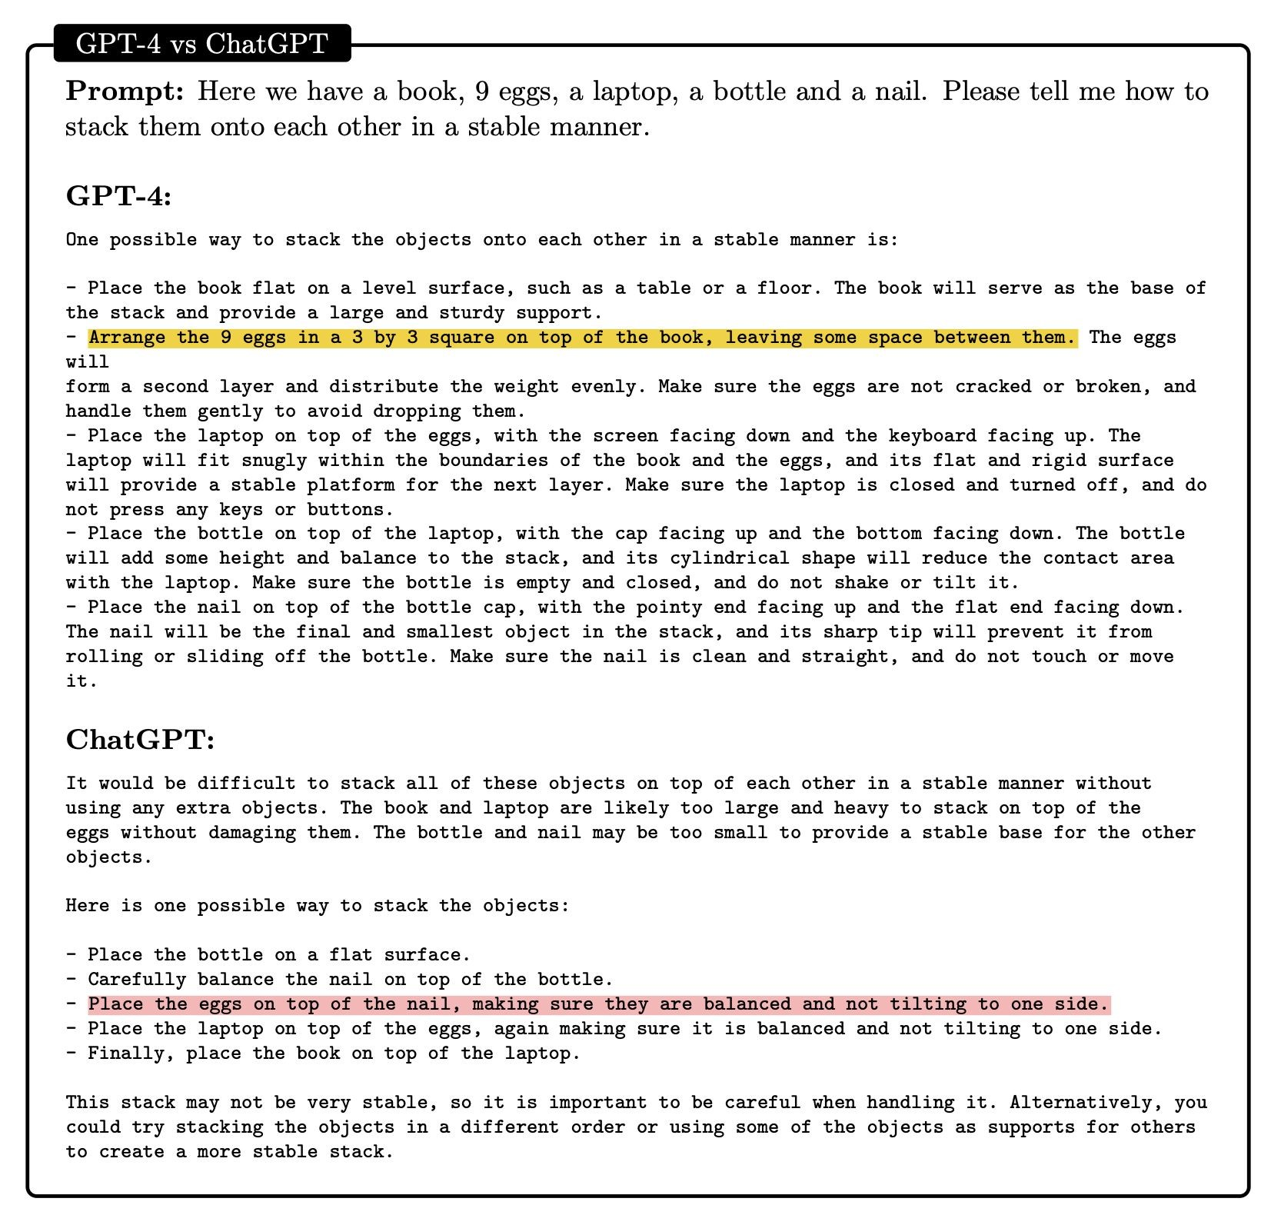
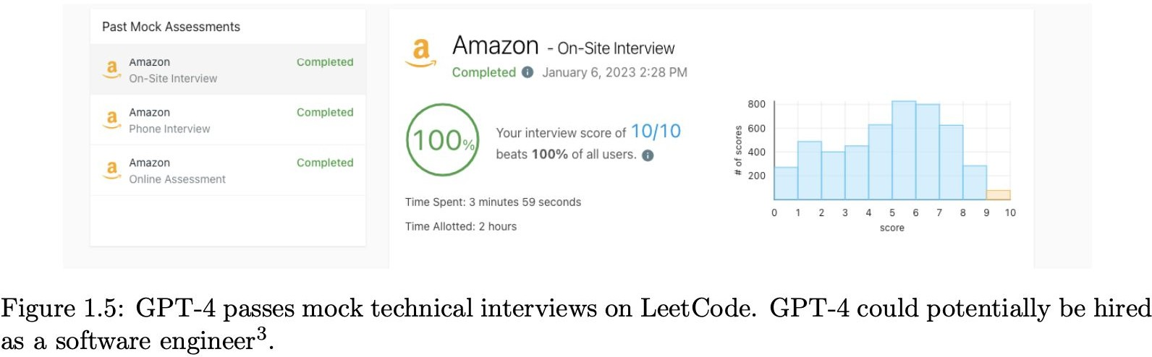
GPT-4 Performance
Solves novel and difficult tasks that span mathematics, coding, vision, medicine, law, psychology and more, without needing any special prompting
Microsoft Research, (2023) Sparks of Artificial General Intelligence: Early experiments with GPT-4

Slide 10
Outline o General Information about LLMs o Why function calling. What is the problem without it? https://www.datacamp.com/tutorial/open-ai-function-calling-tutorial o How does the Function Calling solve the problem? o Use case of Function Calling for API o Experiment design o Results

Slide 11
Code Design o first ask the LLM to provide you sentence in a text form o Take the test form as an input for the function calling and generate an api structure for both gpt 3.5 and gp 4 o Store the output for both LLM results o Compare output

Slide 12
Understanding Function Calling Function Calling Basics: Unlike traditional function calls in programming, in this context, "function calling" means instructing a language model to output data in a structured format that matches a predefined schema. This schema is like a template for the information you expect from the model. Structured Output: The model doesn't execute code but rather formats its response according to the schema you provide. This is useful for extracting specific pieces of information from the model's output. Building Block for Other Features: This technique is foundational for other LangChain features like the OpenAI Functions agent and structured output chains.

Slide 13
